Slide 1
Selecting locations for pizza outlets
Abhijit das – apr2020

Slide 2
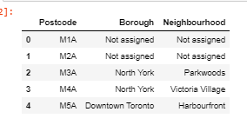
Extract canada neighborhood data
Scrape Wikipedia webpage to extract Toronto postal code (this was done in week 3 and 4)
Postal codes saved in csv file
Load postal codes from csv file. Data contains Postal Code, Borough, Name of Neighborhood,

Slide 3
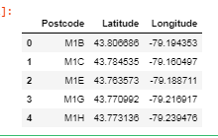
Canada geo data
Load Canada geo location data from csv file (http://cocl.us/Geospatial_data)
The location data contains postal code and their latitudes and longitudes

Slide 4
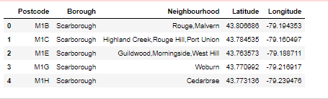
Canada neighborhood and geo data combined
The two dataframes for Canada are combined to consolidate the neighborhood data

Slide 5
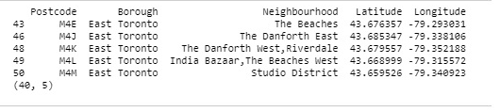
Toronto neighborhoods from Canada data
Separate the Toronto neighborhoods

Slide 6
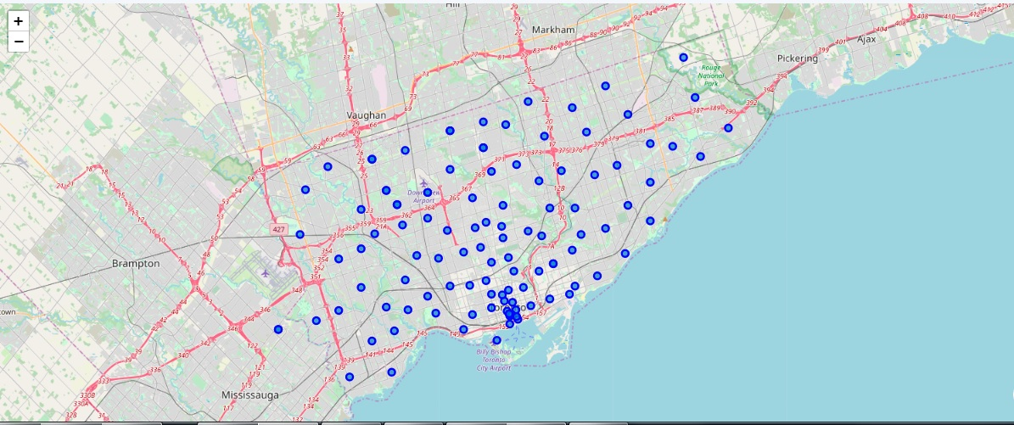
Toronto neighborhoods

Slide 7
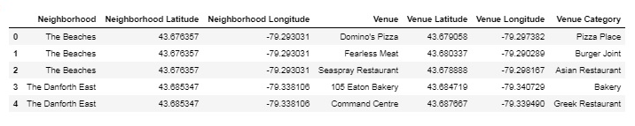
Toronto venue data from foursquare
Using Foursquare API, location data is extracted for Toronto neighborhoods. Location data for single locations is as shown below.
Each venue has a “venue category"

Slide 8
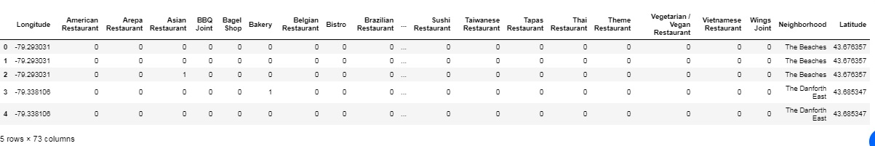
Venue data one-hot encoded by category types
This data contains one row for every venue, data needs to be cleaned and combined
The “category column” associated with the venue has a “one” all other columns have a zero. Hence there are multiple rows for venues in a neighborhood

Slide 9
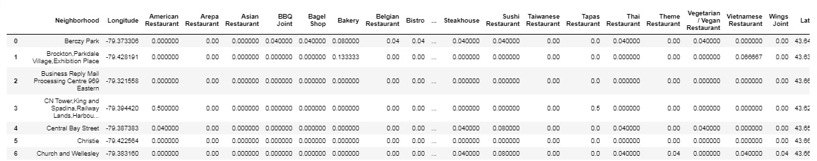
Neighborhood venue dataframe
The one-hot encoded venue data is combined to create one row for every neighborhood. The columns contain the mean of the number of times a venue category appears in that neighborhood, this provides the weight of each venue category in a neighborhood

Slide 10
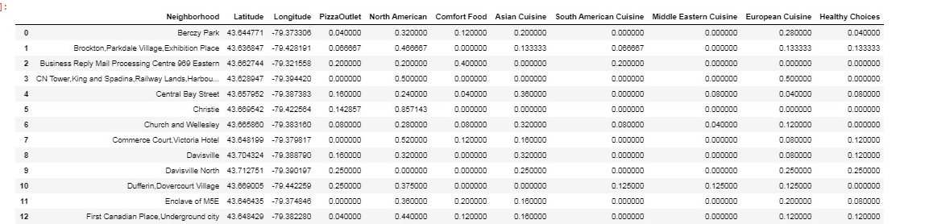
Summarize venue categories into 8 categories
There are venue categories which are similar, like “Noodle house” and “Chinese”, these essentially belong to one type “Asian”. The weights of “Noodle house” and “Chinese” is combined into “Asian”.
The venue categories are grouped into 8 categories to create a new dataframe, the weights of the venue categories are combined into 8 summarized categories

Slide 11
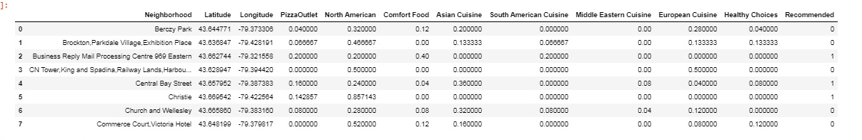
Create training data
The locations having the “PizzaOutlet” as popular category, I have taken that as rating higher that 0.1 are marked as recommended. The others are marked not-recommended.
A subset of this is selected as the training data, following is the training data
A classification model algorithm “K-Nearest Neighbor” is used to build the model
The model is then used to predict which locations would be favorable for pizza locations

Slide 12
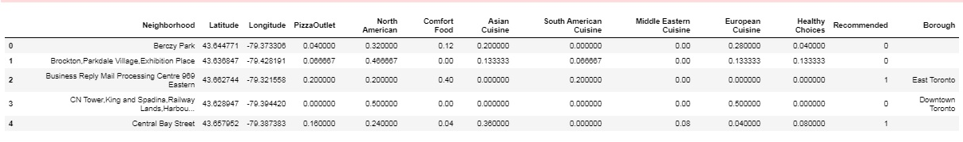
Predicted results
The model is used on the entire dataset to predict which locations are favorable for pizza locations. The prediction is the “Recommendation” field as “0” for “Not recommended” and “1” for recommended.
The predicted “recommendation” is merged into the original dataset for plotting a map

Slide 13
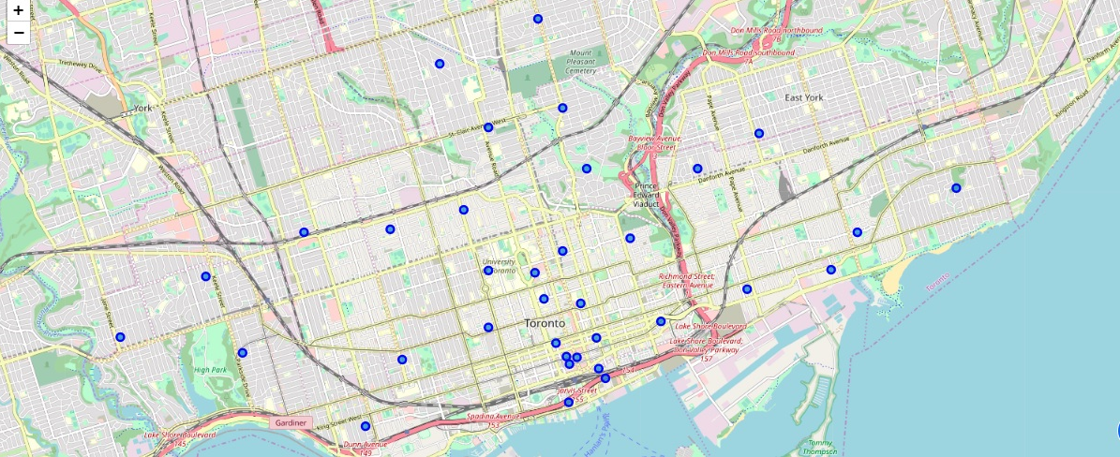
Plot of Toronto locations recommended for pizza outlets
The map below shows the Toronto neighborhoods that are recommended for pizza outlets

Slide 14
Thank you
Thanks for reviewing my Capstone Project – Abhijit Das

